Slide 1
The Context in which HRM takes place
Session 2/10
Part I

Slide 2

HR Challenges at
How IBM viewed the competitive landscape?
  Trade and investment flows across national boundaries had liberalized
  Protectionism was reducing
  Technological advances vastly lowered the cost of global communications and business computing

Slide 3
HR Challenges at
  The production of goods and services flowed globally to the places where the greatest benefit could be created at the most efficient cost
  Future organizations (IBM’s clients) would evolve from the traditional “multinational” approach, which organized production market by market, within the traditional boundaries of the nation-state to Globally Integrated Organizations.

Slide 4
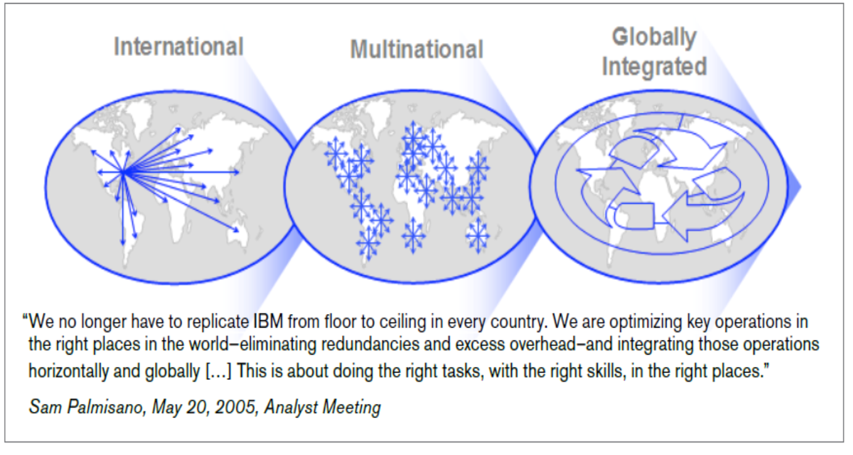
HR Challenges at

Slide 5
HR Challenges at
A 2007 paper published by the IBM Institute for Business Value identifies 7 keys to succeed in a globally integrated world of business. They are:
Understanding the demographics and capabilities of the workforce.
2. Predicting future labour supply and demand.
3. Utilizing social networks to increase visibility and application of knowledge across the organization.
4. Enabling individuals to perform work regardless of location.
5. Facilitating collaboration across traditional organizational boundaries.
6. Driving the rapid development of skills and capabilities to meet changing business conditions.
7. Evaluating employee performance and providing appropriate feedback.
They were concerned with
Understanding demographic trends
Attracting, developing and deploying a capable workforce

Slide 6
What are the key factors driving change in the business environment?
  The increasing pace of globalization
  The rise of new economy sectors
  Changing competitive landscapes and changing employment relations

Slide 7
What ideas do you associate with Globalization?
  Access padlet using the link below
  Login in via Microsoft and using your KCL credentials

